Slide 1

String Representation
Strings are defined as an array of characters. The difference between a character array and a string is the string is terminated with a null character ‘\0’.
In C, a string can be referred to either using a character pointer or as a character array.
When strings are declared as character arrays, they are stored like other types of arrays . e.g., char str[4] = “mam”;
Pointer to string in C can be used to point to the starting address of the array, the first character in the array. These pointers can be dereferenced using the asterisk * operator to identify the character stored at the location.
char array
string
M | A | M
M | A | M | \0
char str[4] = “MAM”;
char *ptr = str;
Address
8000
100
101
102
103
Address
Value
100
M | A | M | \0
Value
ptr

Slide 2
String Manipulation
String manipulation basically refers to the process of handling and analyzing strings. It involves various operations concerned with modification and parsing of strings to use and change its data.
Concatenation of Strings: The process of combining more than one string together is known as concatenation. String concatenation is the technique of combining two strings. Below is the algorithm for the concatenation of two strings:
VOID CONCATENATE (STR1, STR2, STR3)
1. LEN1 = LENGTH(STR1)
2. LEN2 = LENGTH(STR2)
3. SET I = 0
4. Repeat Steps 5 and 6 while I < LEN1-1:
5. STR3[I] = STR1[I]
6. SET I = I+1
7. SET J = 0.
8. Repeat Steps 9 to 11 WHILE I < (LEN1 + LEN2 - 2):
9. STR3[I] = STR2[J].
10. J = J+1.
11. I = I+1.
12. EXIT

Slide 3
String Manipulation cont’d
INT LENGTH(STR1)
1. SET LEN = 0 AND I = 0.
2. Repeat Steps 3 to 4 while STRING[I] IS NOT NULL
3. LEN = LEN + 1
4. SET I = I + 1
5. EXIT
Home Work
Check whether a string is binary string. A binary string is a special kind of string made up of only two types of characters, such as 0 and 1. For example:
Input: str = "01010101010"
Output: Yes, it is a binary string
Input: str = “CS 07"
Output: No, it is not a binary string

Slide 4
String Manipulation Home Work
Develop an algorithm to check whether a string is palindrome. A string is said to be a palindrome if the reverse of the string is the same as the string.
Develop an algorithm to find a character in string.
Develop an algorithm to find a substring in another string.
Develop an algorithm to trim the string. Below is a simple solution:
Iterate through all characters of given string, do following:
If current character is a space, then move all subsequent characters one position back and decrease length of the result string.
Develop an algorithm to reverse a string. The reversing of a string is nothing but simply substituting the last element of a string to the 1st position of the string.
Develop an algorithm to convert a string to lower and upper case.

Slide 5
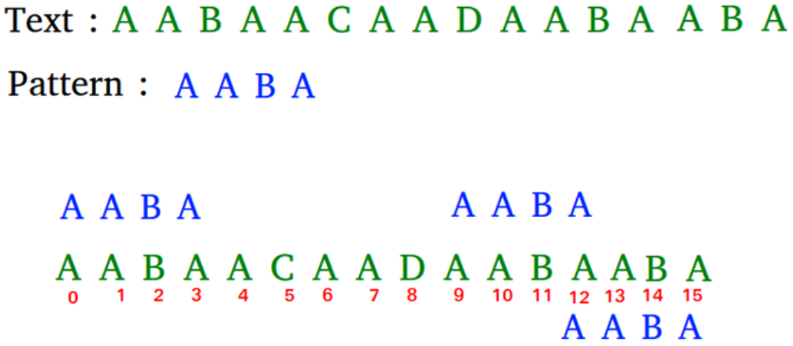
Pattern Matching
Pattern matching is searching a given pattern in the string.
Pattern found at?

Slide 6
Pattern Matching Algorithm
for (c = 0; c <= text_length - pattern_length; c++)
{
position = e = c;
for (d = 0; d < pattern_length; d++)
{
if (pattern[d] == text[e])
{
e++;
}
else
{
break;
}
}
if (d == pattern_length)
{
return position;
}
}
return -1;
int match(char text[], char pattern[])
{
int c, d, e, text_length, pattern_length, position = -1;
text_length = strlen(text);
pattern_length = strlen(pattern);
if (pattern_length > text_length)
{
return -1;
}
}
What is the drawback in the algorithm?

Slide 7


